Slide 1
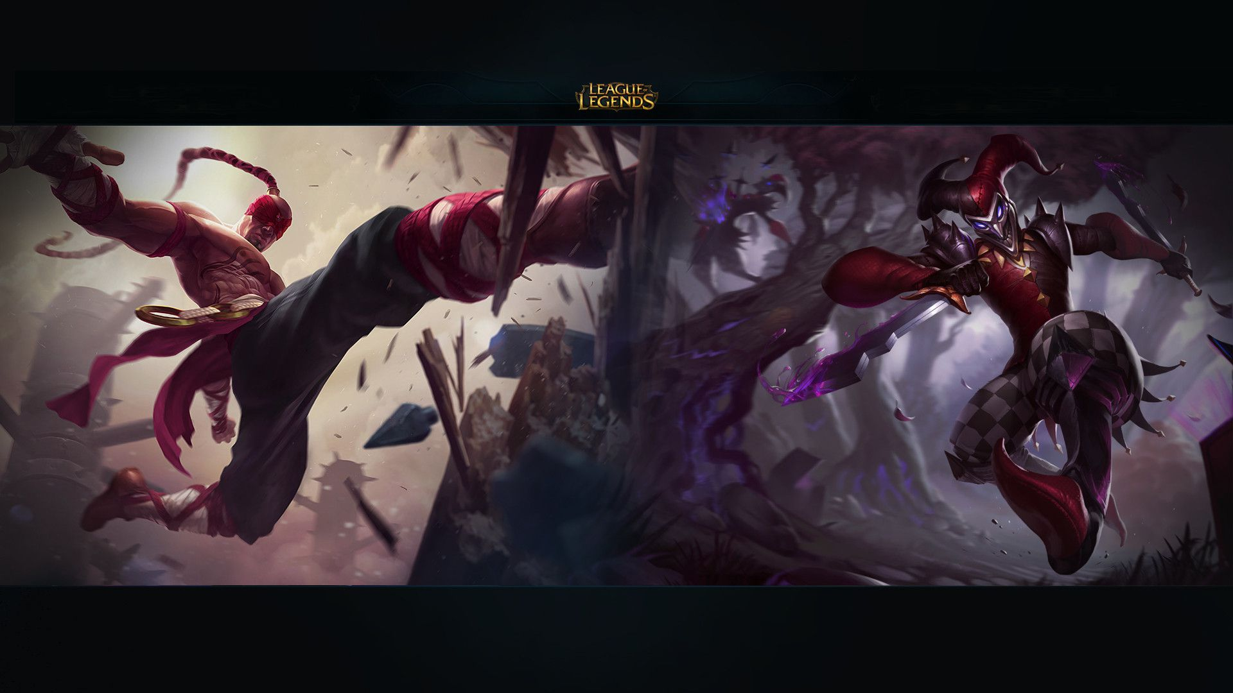
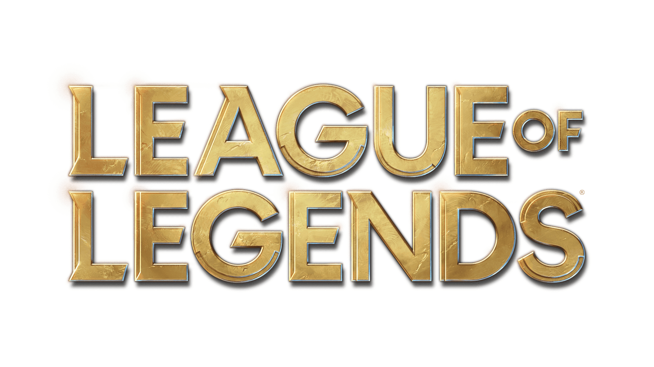

Predicting Game Outcome
with Machine Learning
Notes:
Linh

Slide 2
Table of contents
Short Intro
Overview
Data Selection and Preparation
Feature Engineering and selection
Model Building and Evaluation
Hyperparameter Tuning
Real world application & impact
Future Work & Improvements
Challenges and Learnings
Notes:
Linh - explaining the game and the dataset

Slide 3
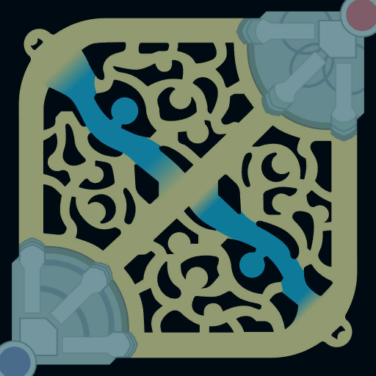
Short Intro
Base
Goal: Destroy Base
3 Lanes
Gold rewards, for several
accomplishments
5 vs 5
top
mid
Base
bot
Notes:
Linh - explaining the game and the dataset

Slide 4



Project Overview - The Game
Gold
Monster
Lanes & Tower
Buildings
used to buy Items and get stronger
drop gold
some monsters give buffs
3 Lanes where PVP happens
Jungle PVE area
Players drop Gold on death
While a player is dead =
less income or impact on the game
towers can attack and defend
goal is to destroy towers and reach deeper into enemy base
team wins by destroying their main building at the end of a lane
Notes:
Michi
Brief introduction to your chosen topic and the machine learning problem you’re addressing.
State the objective and potential impact of your project.

Slide 5
Data Selection and Preparation
Searched for Data
Data Cleaning
Step #2
Step #4
Step#1
Step #3
Download
Feature Selection

Slide 6
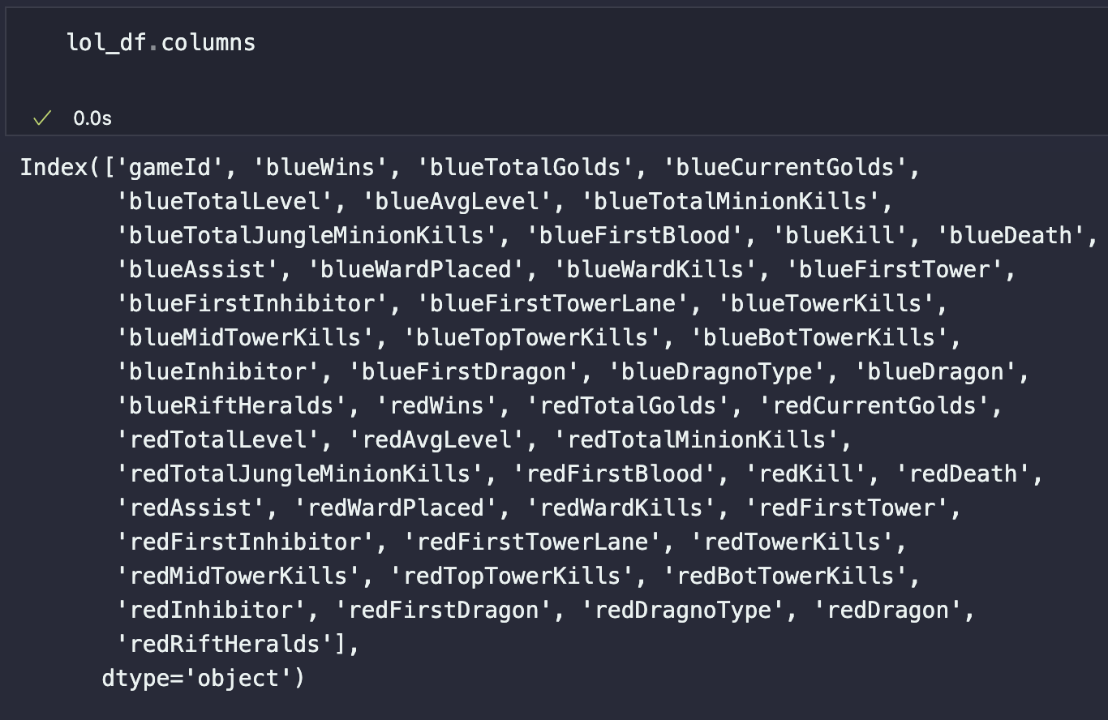
Data Selection and Preparation
characteristics
blueWins and redWins: Binary columns indicating if the blue or red team won.
Shape 26.834 x 56
Team Statistics for blue and red equivalent example: blueTotalGolds, blueCurrentGolds, blueTotalLevel
Game-specific Attributes for blue and red equivalent: blueTowerKills, blueMidTowerKills
Notes:
Data Selection - Linh

Slide 7
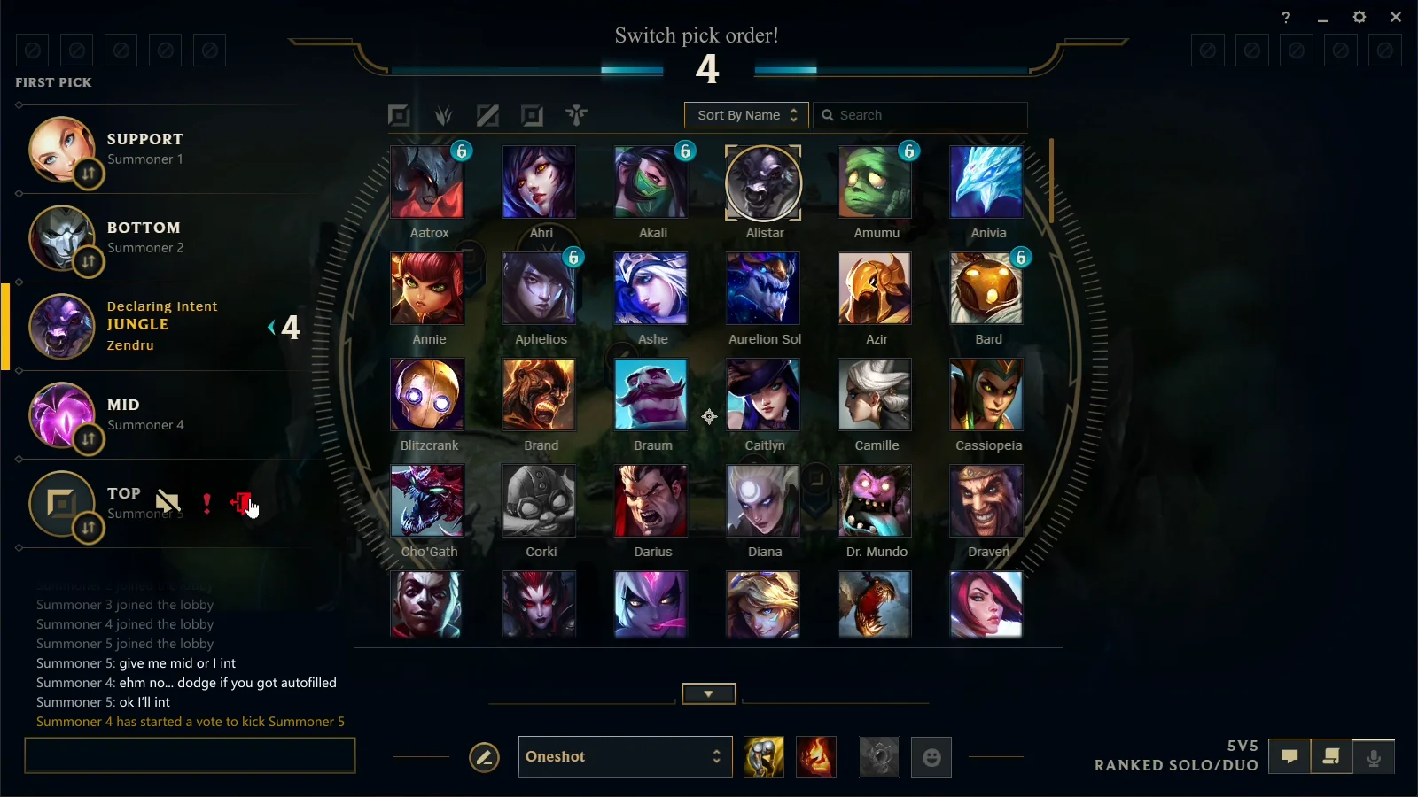
Feature Engineering and Selection
Feature Selection
Identify Redundant Features: We created a correlation matrix to find feature pairs with high correlation, indicating redundancy.
Retain Predictive Features: In each correlated pair, we kept the feature with a stronger correlation to the target to maximize predictive power.
Remove Low-Impact Features: We dropped features with low correlation to the target, reducing noise and enhancing model focus.
Notes:
Linh

Slide 8
Feature Engineering and Selection
Drop redWins
Blue side Wins
drop redWins
Defining Target - Binary (W or L)
Dragon Feature
Manual Selection
Feature Selection
Dummy Function adds more than 70 features
if deemed important feature by us, we didnt kick it
90% above feature to feature
kick feature with less corr to target
5% - (-5%)and less feature to target kick
Notes:
michi

Slide 9
Model Building and Evaluation
Knn Neighbors
Logistic Regression
Random Forest
N = 10
Score: 0,7378
Accuracy: 0,8084
F1 Score: 0,8084
Iter: 1000
Accuracy: 0,8041
F1 Score: 0,8041
Bagging
few
Gradient Boosting
Accuracy: 0,8084
F1 Score: 0,8084
Estimators: 15
Accuracy: 0,8114
F1 Score: 0,8114
Estimators: 100
Depth: 3
learning rate: 0,17
Notes:
Michi

Slide 10
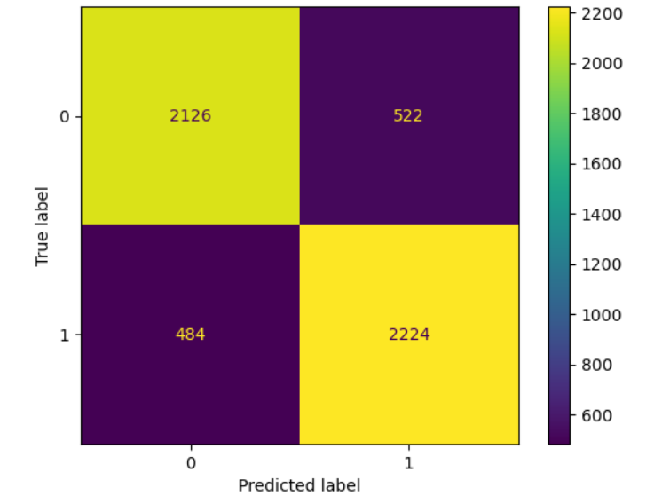
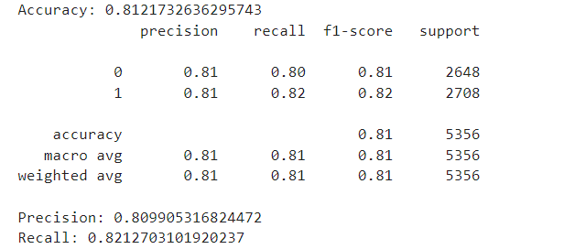
Model Building and Evaluation
STACKING
Notes:
Michi

Slide 11
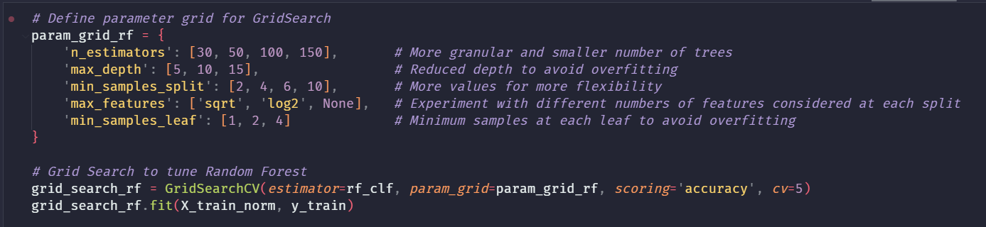
Hyperparameter Tuning and Model Optimization
HyperTuning with GridsearchCV
somehow lesser accuracy
very time consuming
fine tuning was hard
+ 100 minutes
Notes:
Linh

Slide 12


Real World Application and Impact
print Money
extract data during live games at 15 minutes
predict outcome of matches to bet
selling information
Limitations:
game has consistent updates -> can skew results
new data needed after every update
e-sports betting isn’t as big as normal sports
prone to player manipulation
Notes:
Michi

Slide 13
Challenges and Learnings
Fetch redundant Data → perfect score, problem was redWins feature, forgot to drop
Hyperparameter Tuning and Model Optimization can be time consuming
Finding data
Notes:
Linh

Slide 14
Future Work and Improvements
fine tune more to get accuracy a bit more up
computational power to squeeze accuracy up
add Heroes to Dataset
add Items to Dataset
tool to extract data from livestream
rank based (data is extracted from highest rank)
test if accuracy applies to lower ranks
Notes:
Michi

Slide 15
THANK YOU

